Slide 1
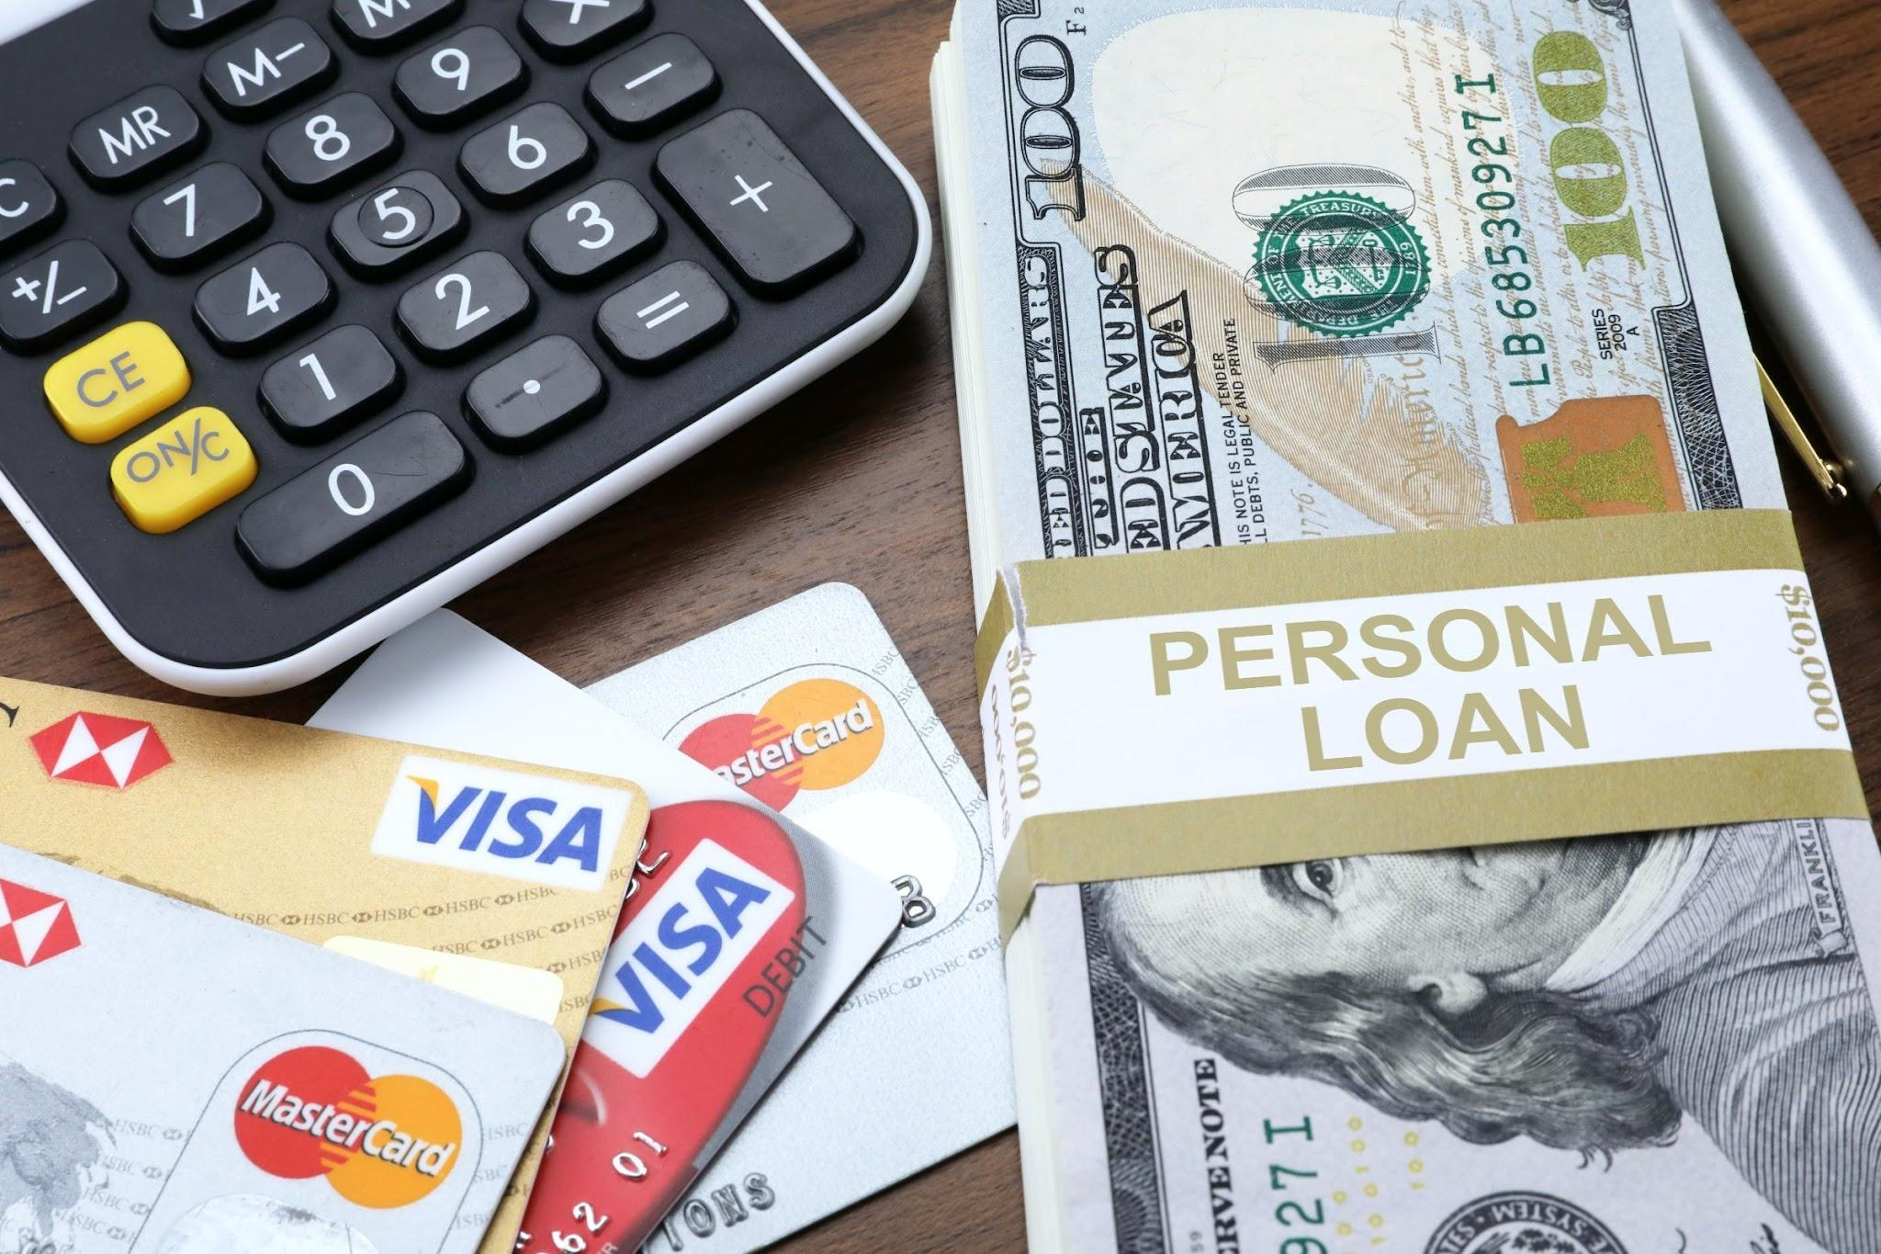
Credit Loan Eligibility
By: Jessica Zhao, Dayana Iciano, and Colven Benjamin

Slide 2

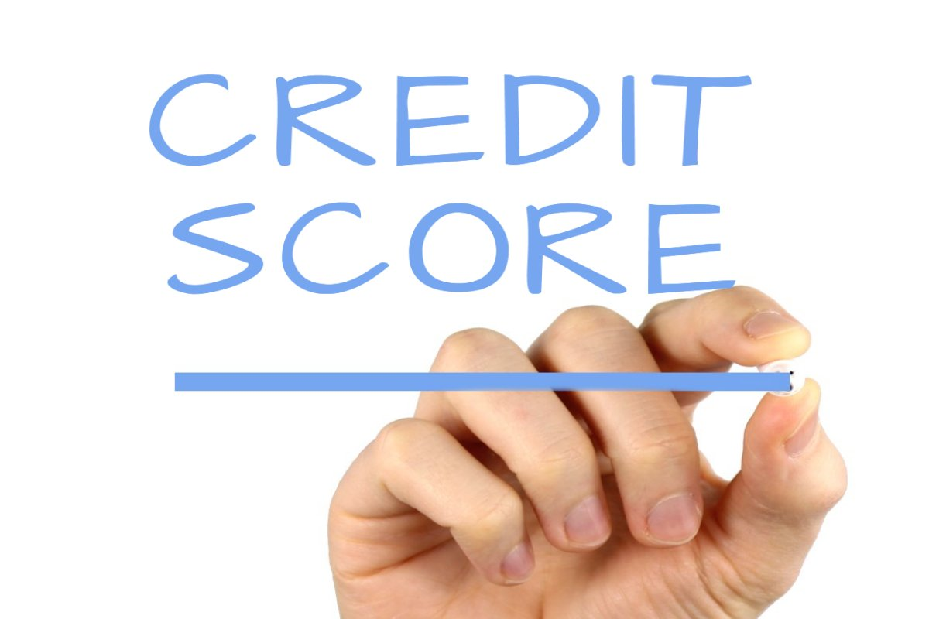
Project Proposal
The topic we chose to work on was finance specifically focused on credit.
Certain questions we hope to answer with our data would be the correlation between education/income level and credit card debt, age and the average credit scores.
Our Target Task-
Is to create an algorithm that analyzes credit scores and predicts consumer personal loan eligibility using based models with the help of machine learning.

Slide 3


TOOLS AND LANGUAGES
The tools we used for machine learning were the following:
Tableau
Dashapp
The languages used were the following:
Python

Slide 4
PACKAGES USED
The Packages Used:-
Pandas: Used for data manipulation and analysis
Numpy: Used for numerical computations and array operations
Seaborn: Used for data visualization and statistical plotting
Matplotlib: Used for creating static, interactive, and animated visualization
Csv: Used for reading and writing CSV files

Slide 5
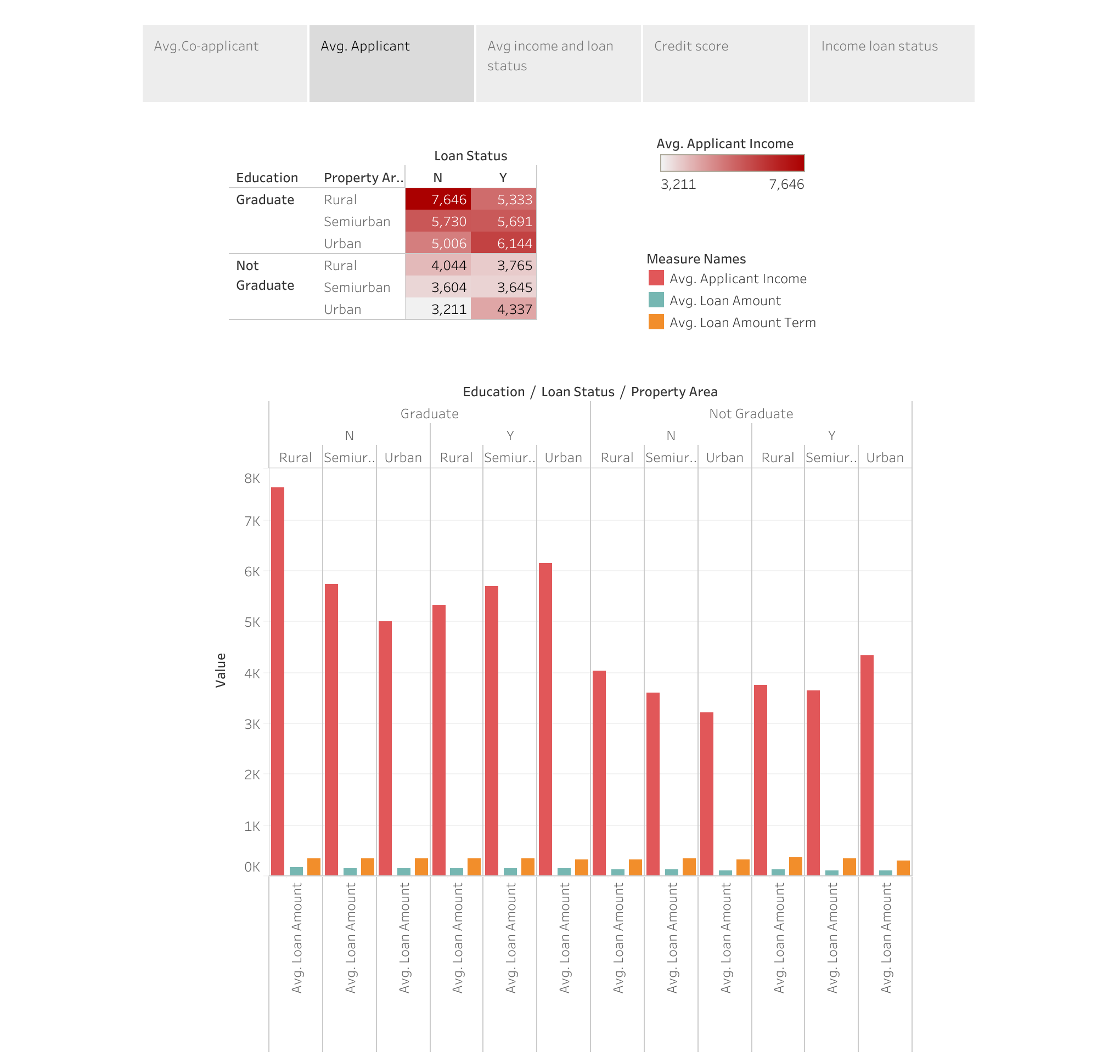
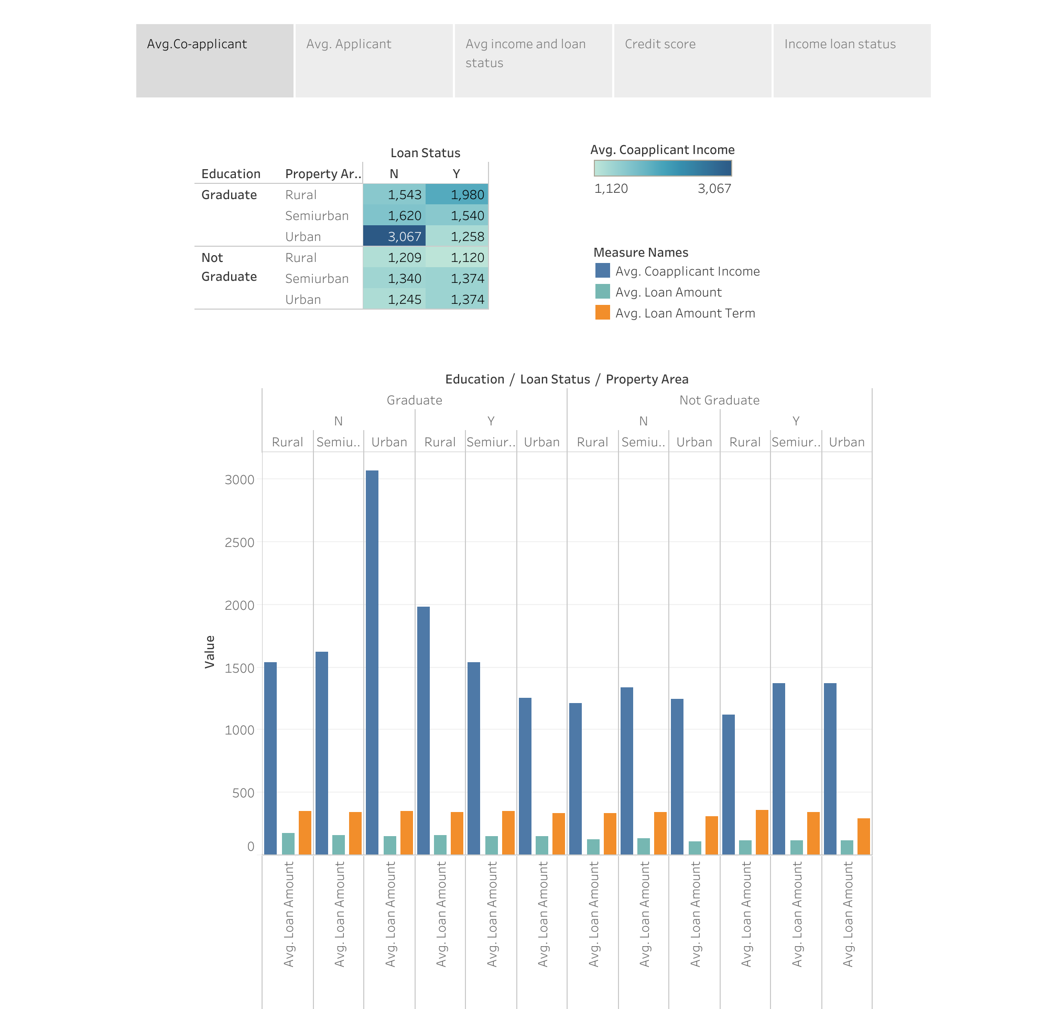
VISUALS

Slide 6
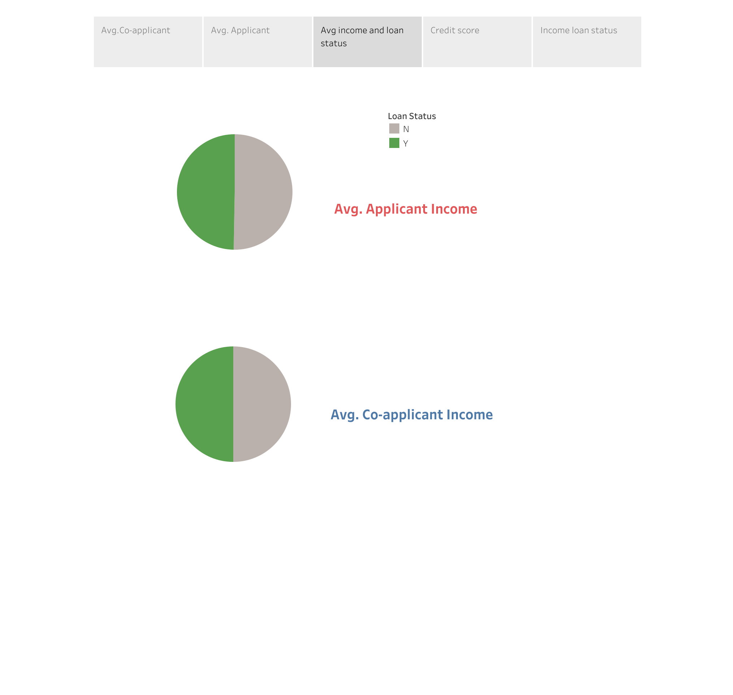
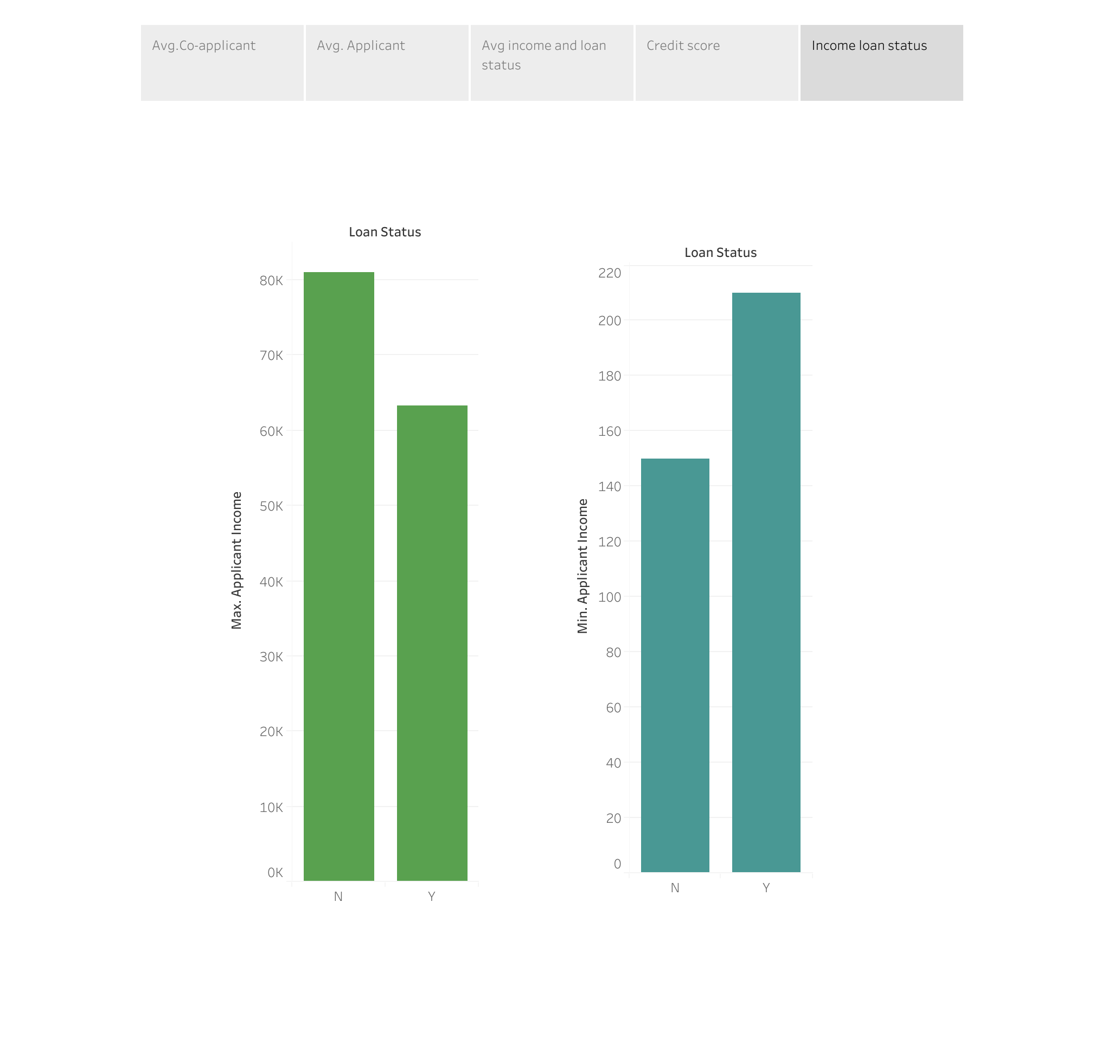
Visuals

Slide 7
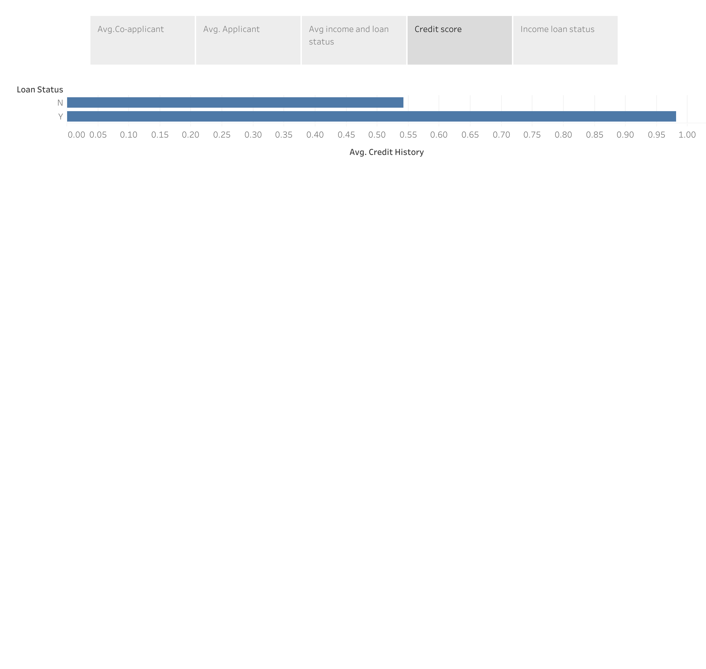
VISUALS

Slide 8
Links
Datasource- https://www.kaggle.com/datasets/prakharrathi25/loan-prediction-data?resource=download
Inspiration- https://towardsdatascience.com/predict-loan-eligibility-using-machine-learning-models-7a14ef904057
Github Repo- https://github.com/zhaojay47/Group-2-project-4/tree/main
Tableau- https://public.tableau.com/app/profile/jessica.zhao/viz/Loan_16910809450200/Story1?publish=yes

